Slide 1
Real Time Speech To Text Translation
DEPI Final Project

Slide 2
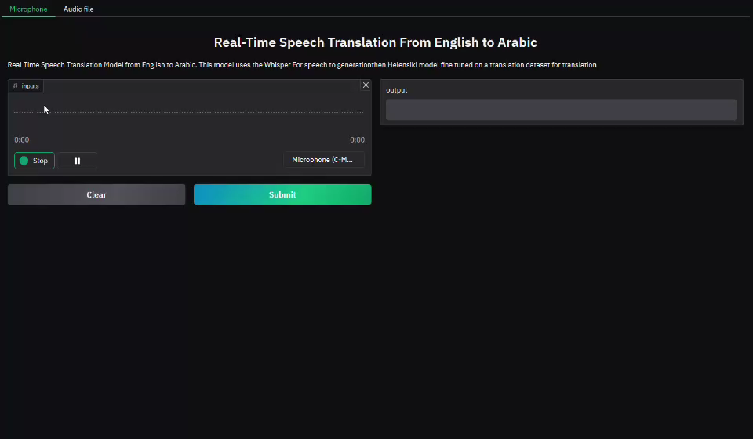

Slide 3
Team Members
Ahmad Hazem Ahmad
Radwan Mohammed
Ahmed Elsayed Abdellah
Mahmoud Ramdan
Abdallah Mohammed
Nourhan Elgendy
Ibrahim Mohammed

Slide 4
Outline
Dataset Searching
Common Voice
Feature Extraction
Whisper Model
Helsinki
Evaluating the Translation Model
GANs & Augmentation
Deployment & Demo

Slide 5
We searched for datasets in Kaggle and Hugging Face. Here are some of the datasets that we found and why they weren't suitable for the project:
1) "Deep Voice - Deepfake Voice Recognition" dataset from Kaggle
2) "LJ Speech " dataset from Kaggle
3) "English-to-Arabic-translate" dataset from Hugging Face

Slide 6
1) "Deep Voice - Deepfake Voice Recognition" dataset from Kaggle is not suitable for your real-time speech recognition and translation project for several reasons:
1
2
Designed for deepfake voice recognition
contains tall or long audio files typically used for deepfake detection

Slide 7
2) "LJ Speech Dataset" from Kaggle has several disadvantages that make it unsuitable for real-time speech recognition and translation project:
Contains speech from only one person
Narrow range of linguistic diversity and features
Contains only English speech

Slide 8
2) "LJ Speech Dataset" from Kaggle has several disadvantages that make it unsuitable for real-time speech recognition and translation project:
Dataset is recorded in controlled, high-quality conditions
The speech in this dataset comes from reading structured text

Slide 9
3) "English-to-Arabic-translate" dataset from Hugging Face is not suitable for real-time speech recognition and translation project due to several key reasons:
Consists of text-to-text translations, provides pairs of English text and their corresponding Arabic translations
We cannot apply audio preprocessing techniques
1
2

Slide 10
Summary of problems in the datasets we saw:
"Deep Voice - Deepfake Voice Recognition" dataset did not contain natural speech audio nor multilingual transcripts to train both the speech recognition and machine translation models effectively.
"LJ Speech " dataset limited by its single speaker, lack of feature diversity, absence of multilingual and real-world audio conditions.
"English-to-Arabic-translate" dataset text-based and lacks the audio data and speech required for real-time speech recognition and translation project.

Slide 11
Introduction to Common Voice Dataset
Common Voice is an open-source project that provides a crowd-sourced dataset of voice recordings in multiple languages to support the development of speech recognition technologies

Slide 12
Slide : Components of the Dataset
clips/
This folder contains the actual audio clips, which are recordings of volunteers reading sentences
clip_durations.tsv
A metadata file that lists the duration of each audio clip
dev.tsv
This file contains a subset of audio clips and their corresponding metadata, typically used for model development and testing during training
invalidated.tsv
This file contains recordings that were marked as invalid by reviewers or by automatic validation processes
test.tsv
This file contains metadata and references for the test set of audio clips
times
It seems this file might store timing information related to the dataset or the processing of the clips
train.tsv
This is the main training dataset, containing the majority of the audio clips and their metadata
validated.tsv
This file contains clips that have been successfully validated by the community or automated processes, making them suitable for training and testing purposes

Slide 13
Slide: Metadata in train.tsv
client_id
A unique identifier for the volunteer who recorded the clip
path
The relative file path to the audio clip stored in the clips/ folder
sentence
The text that the speaker was prompted to read
age
The age group of the speaker
gender
The gender of the speaker
accent
The speaker’s accent or regional dialect

Slide 14
Preprocessing and feature extraction

Slide 15
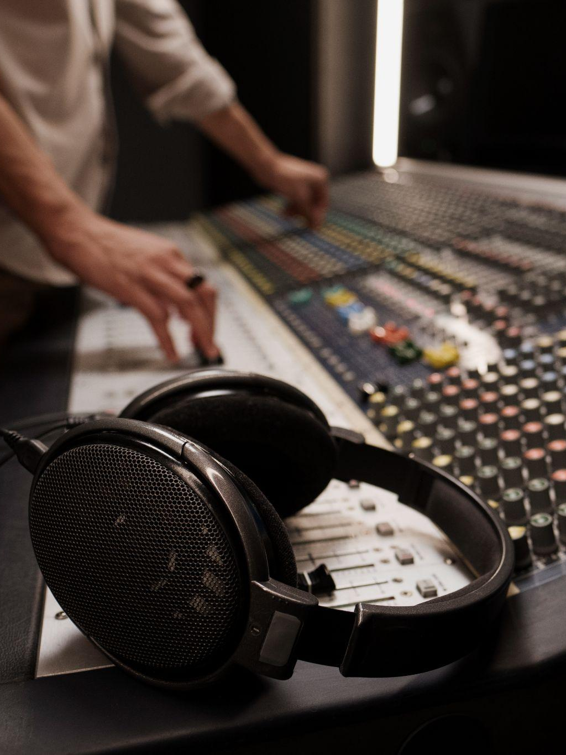
to build a robust, real-time speech recognition and translation system. We realized that the success of our model would depend heavily on how well we processed the raw audio data before feeding it into a machine learning model.

Slide 16
Understanding the Challenges of Raw Audio
Raw audio signals are complex and often contain not only speech but also background noise, silences, and other unwanted sounds.
Searching for the Best Preprocessing Techniques
A. Raw Audio Input: One of the first ideas we explored was using raw audio input.
Feature Extraction Search: Mel-Spectrogram Discovery
B. STFT (Short-Time Fourier Transform
B. Silence Removal and Segmentation : long periods of silence were cut out of the audio signal.
C. Noise Reduction
A. MFCC (Mel-Frequency Cepstral Coefficients)
C. Mel-Spectrogram

Slide 17
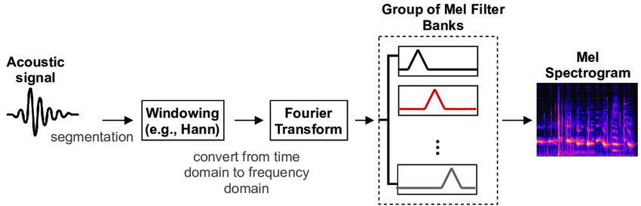
Feature Extraction Search: Mel-Spectrogram Discovery

Slide 18
Feature Extraction Search: Mel-Spectrogram Discovery
A. MFCC (Mel-Frequency Cepstral Coefficients)
they have limitations when it comes to real-time applications. The complexity of calculating MFCCs made them less suitable for low-latency scenarios, and they were not as adaptable to noisy environments.
B. STFT (Short-Time Fourier Transform)
we found that the linear frequency scaling of STFT did not align with how humans perceive sound. Also, it resulted in a large amount of data, which could slow down the model in real-time applications.

Slide 19
Feature Extraction Search: Mel-Spectrogram Discovery
C. Mel-Spectrogram:
Eventually, we discovered that the Mel-Spectrogram was the ideal method for feature extraction. Here's why:
Mel Scaling: The Mel scale more closely mimics how humans hear frequencies, focusing on the parts of speech that are most important.
Low Dimensionality: Compared to raw audio or STFT, Mel-Spectrograms offered a much more compact representation, allowing for faster computation.
After testing Mel-Spectrogram on a small subset of audio samples, we saw a significant improvement in both speed and recognition accuracy

Slide 20
Refining the Preprocessing Pipeline
B. Noise Reduction and Normalization
C. Mel-Spectrogram Computation
A. Resampling
We resampled all audio to a common sample rate (e.g., 16 kHz) to ensure that every input to the model had a consistent format, which helped reduce unnecessary variability in the data.
Basic noise reduction was applied, and we normalized the audio to a standard amplitude range. This step ensured that the model didn’t have to deal with large variations in volume.
frame was transformed into a Mel-Spectrogram. The resulting Mel-Spectrogram was then passed to the model for processing With this pipeline, we achieved low-latency preprocessing, making it viable for real-time.

Slide 21
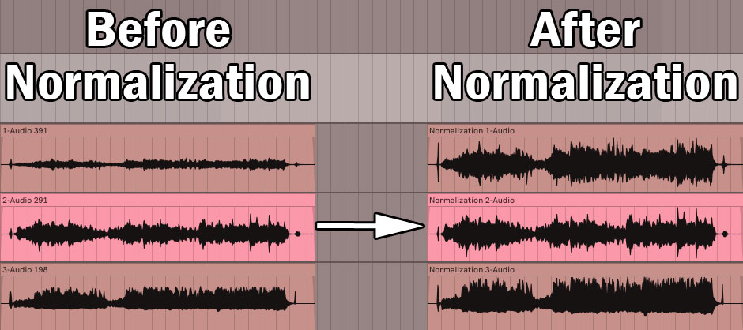
B. Noise Reduction and Normalization

Slide 22
Choosing the Whisper Model
With our preprocessing pipeline optimized, the final step in our journey was finding the right model for speech recognition and translation. After considering various models, including RNNs and LSTMs, we chose the Whisper model because:
1
2
handles noisy and diverse datasets
3
The model is based on transformers
multilingual speech recognition

Slide 23
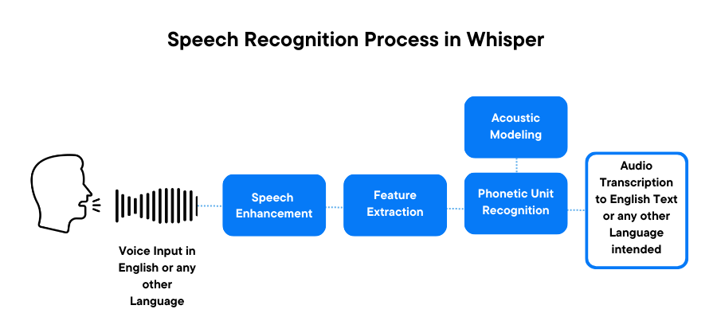
Choosing the Whisper Model

Slide 24
Enhancing Whisper Model: Objective & Approach
Objective:
- Improve transcription accuracy for English voice notes
Whisper Model Strengths:
- Robust at handling multiple languages and accents
- Strong performance in noisy environments
- OpenAI's state-of-the-art model for speech-to-text tasks
Approach:
- Curated datasets and fine-tuned Whisper model
- Adjusted hyperparameters and leveraged Python (Hugging Face)
- Used available GPU resources for training

Slide 25
Challenges, Limitations & Outcome
Challenges & Limitations:
- Limited computational resources.
- Insufficient capacity to effectively fine-tune on the Common Voice dataset
- Lack of access to high-quality annotated datasets beyond Common Voice
Outcome:
- Fine-tuning effort did not yield desired improvements
- Gained insights for future work on Whisper's limitations

Slide 26
TRANSLATION

Slide 27
TRANSLATION
Text from whisper in
Language
“A”
Language
“B”

Slide 28
TRANSLATION
Text from whisper in
Language
“A”
Language
“B”
Helsinki Neural Machine Translation

Slide 29
TRANSLATION
Helsinki Neural Machine Translation
Open Source
Various Language Pairs
High Quality Translation
Transformer
& attention

Slide 30
HNMT Architecture
01
02
03
Encoder
Decoder
Attention Mechanism
Uses the the hybrid character-level encoder /word bidirectional model
Uses byte-pair encoding (BPE) technique
focuses on relevant parts of the input during translation

Slide 31
HNMT TRICKS

Slide 32
Layer normalization
HNMT TRICKS

Slide 33
Layer normalization
HNMT TRICKS
Variational Dropout

Slide 34
Layer normalization
HNMT TRICKS
Variational Dropout
Context
Gates

Slide 35
Layer normalization
HNMT TRICKS
Variational Dropout
Coverage
Decoder
Context
Gates

Slide 36
Layer normalization
Ensembling
HNMT TRICKS
Variational Dropout
Coverage
Decoder
Context
Gates

Slide 37
HNMT Preprocessing
Tokenization and Truecasing
breaking into meaningful linguistic units and converting words to their standard form
Byte-Pair Encoding (BPE)
split rare or compound words into smaller subword units, reducing vocabulary size
01
02
03
04
Handling Morphologically Rich Languages
segment Finnish words into meaningful sub-parts
Dealing with Contractions and Hyphenation
English contractions are expanded and hyphens handling

Slide 38
Fine Tuning HNMT
We used a subset of 80k from a 1.3M row English to Arabic data set
I don’t like it
أنا لا أحب ذلك
It’s none of your business
هذا ليس من شأنك
thats a good question
هذا سؤال جيد

Slide 39
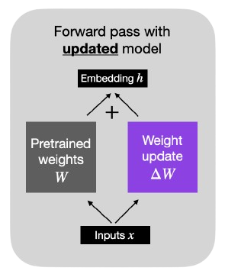
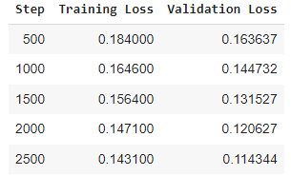
Fine Tuning HNMT
We used LoRA fine tuning
→ Parameter efficiency
→ Reduced training time
→ Lower resource requirements
We reached these loses after experimenting many LoRA Parameters

Slide 40
Evaluation the translation model

Slide 41
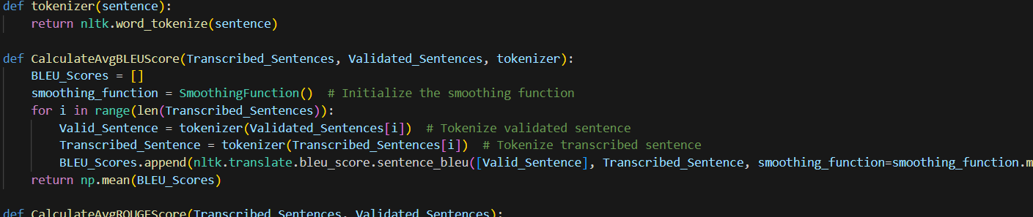
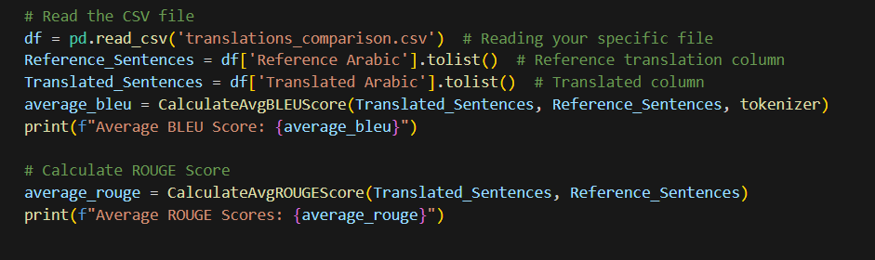
First approach
For the evaluation, two approaches were employed. The first approach involved using the fine-tuned model to translate the dataset, while the second approach translated the same set of samples using the ChatGPT API. The performance of both translations was then compared using metrics such as BLEU and ROUGE to assess translation quality

Slide 42
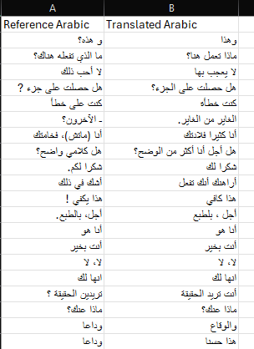
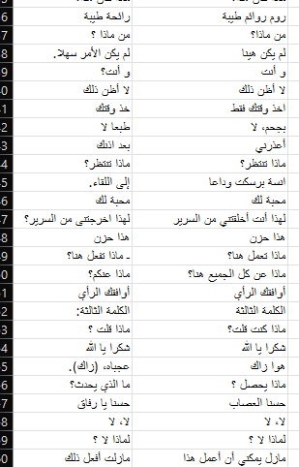
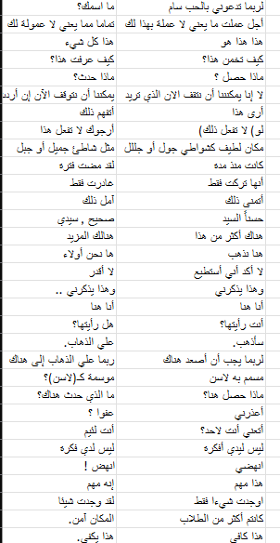
samples

Slide 43
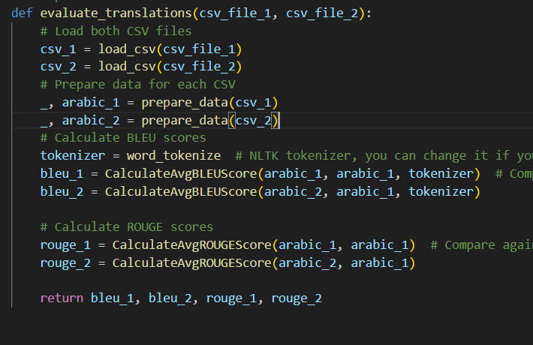
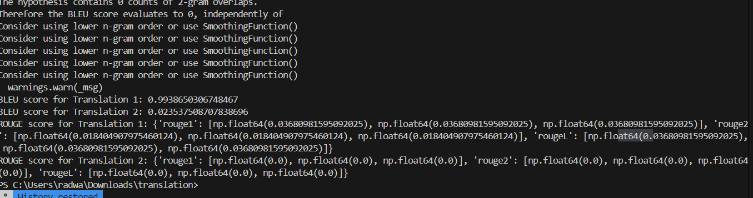
Second approach
For the evaluation, two approaches were employed. The first approach involved using the fine-tuned model to translate the dataset. The second approach involved comparing a dataset containing English sentences and their corresponding Arabic translations. In this approach, the English sentences were translated using the fine-tuned model, and the new translations were added to a CSV file. Both translations from the original and the new CSVs were then compared using performance metrics such as BLEU and ROUGE to assess the quality of the translations.

Slide 44
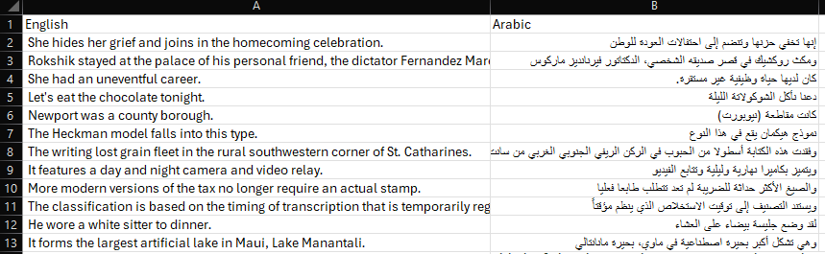
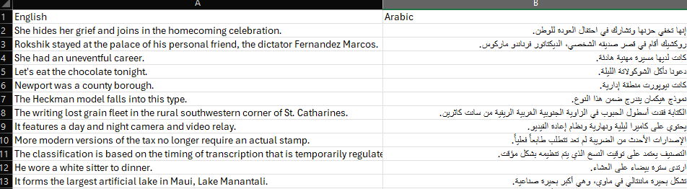
Samples of the csv
Tranlated Data A
Tranlated Data B

Slide 45
Generative Adversarial Networks

Slide 46


Slide 47
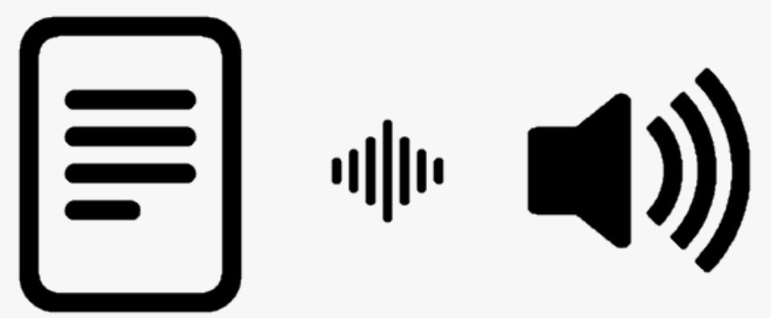
Synthetic Voice Generation
Melo is a high-quality multi-lingual text-to-speech library by MIT and MyShell.ai
We use Melo to create synthetic voices for sentences in the dataset that have no mp3 file
It can also be used to substitute corrupted files and to change the accent of the speaker
seamless integration with our existing workflows accelerates data preparation and enhances the quality of our audio datasets.

Slide 48

Example

Slide 49
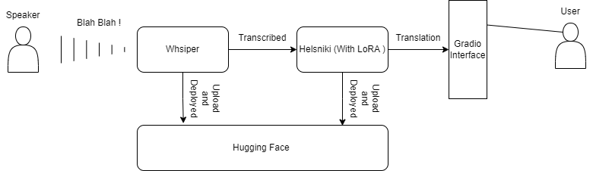
Deployment

Slide 50
Demo

Slide 51
Any Questions ??

